Slide 1


MACHINE LEARNING
Movie Genre Classification

Slide 2

INTRODUCTION
•The importance of Movie genre classification is growing.
•Accurate predictions improve satisfaction and manageing content library.
•Most models use all or a combination of video, audio and text.
•To reduce computational costs our model only uses text.

Slide 3

OBJECTIVES
Text-Based Classification
Model Comparison
Resolving gaps
Evaluation
Scalability & Interpretability
Notes:
Develop a machine learning model to classify movie genres based on textual descriptions.
Compare traditional ML models: CatBoost, XGBoost, and Logistic Regression.
Resolve idetefied gaps in other movie genre classification models.
Evaluate model performance using appropriate classification metrics.
Present a scalable and interpretable alternative to resource-intensive deep learning approaches.

Slide 4

identified gaps
High computational cost.
Dependency on large, specialized multimodal datasets.
Semantic overlap.
Under exploration of boosting methods.
Lack of ML approaches on text data
Notes:
Lack of simpler, interpretable, and scalable ML approaches on text data

Slide 5
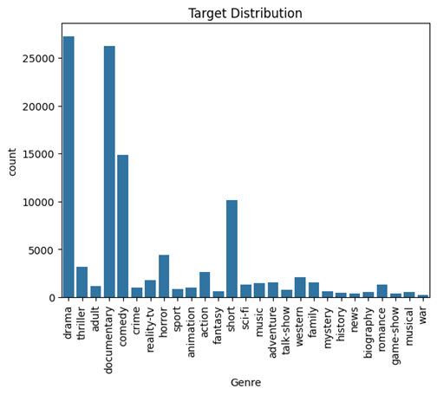
DATASET DESCRIPTION
The dataset comprises approximately 108,000 movie entries, each labeled with a genre and accompanied by metadata such as title, release year, and a textual description.
Initial analysis revealed:
Some missing values in the Year column
Imbalanced genre distribution (Drama, Adult, and Documentary were most common)
A need to handle genre overlap and long-tail distribution

Slide 6

DATA PREPROCESSING
Null Removal
Filtered genres
Text Cleaning
Feature Creation
Label Encoding
Notes:
Removed null entries and duplicates
Filtered to top 3 genres: Drama, Adult, Documentary
Removed entries with fewer than 10 words in the description
Cleaned text (lowercased, removed HTML tags, punctuation, stop words)
Created numeric features: description length and title length
Normalized numeric columns using Min-Max scaling
Applied label encoding to genre labels

Slide 7
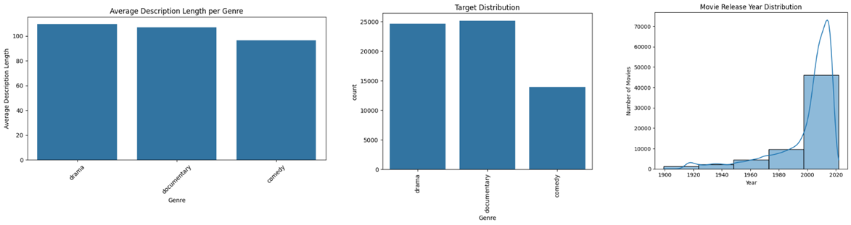
DATA AFTER APPLYING PREPROCESSING

Slide 8
CLASSIFIERS & RESULTS
CatBoost - Handles raw text and categorical features, uses ordered boosting
XGBoost - Efficient gradient boosting with TF-IDF input
Logistic Regression - A simple, interpretable baseline using TF-IDF
Supporting Method: TF-IDF – Used to transform text into numerical values.
Model | Accuracy | Macro Precision | Macro Recall | Macro F1 | Weighted F1
CatBoost | 0.827 | 0.807 | 0.808 | 0.807 | 0.832
XGBoost | 0.769 | 0.762 | 0.747 | 0.749 | 0.764
Logistic Regression | 0.779 | 0.777 | 0.773 | 0.771 | 0.779
Notes:
Text was transformed using TF-IDF, and CatBoost additionally utilized raw text features. Data was split into train, validation, and test sets (70/15/15). Hyperparameters were tuned using cross-validation.

Slide 9
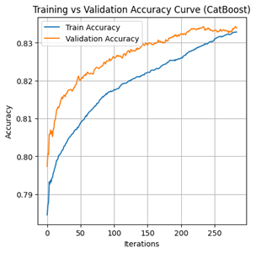
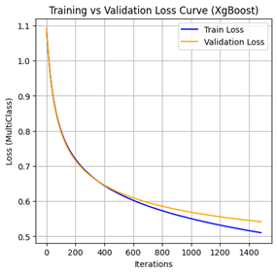
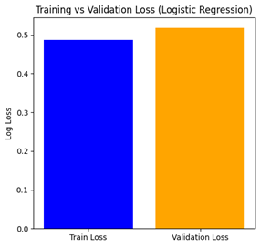
MODEL INSIGHTS
CatBoost showed strong overall performance.
It effectively used raw text and numeric inputs.
Training was stable with minimal overfitting, thanks to ordered boosting.
XGBoost provided robust performance but showed early flattening of the validation loss curve.
It used TF-IDF-transformed features and struggled to capture complex language patterns.
Logistic Regression offered respectable performance as a linear model.
Used the same TF-IDF features as XGBoost.
It was stable and interpretable, but less expressive than ensemble models.

Slide 10

CHALLENGES & IMPROVEMENTS
Challenges:
Class imbalance
Genre overlap:
Limited resource environment
Future Improvements:
Use multi-label classification
Incorporate BERT or Transformer-based embeddings
Expanding the dataset
Notes:
Challenges:
Class imbalance: Some genres had very few entries
Genre overlap: Semantic similarity (e.g., Drama vs. Documentary)
Limited resource environment: Could not use deep learning
Future Improvements:
Use multi-label classification for movies with multiple genres
Incorporate BERT or Transformer-based embeddings
Expand dataset to include underrepresented genres

Slide 11

CONCLUSION
We built a text-based genre classification model using CatBoost, XGBoost, and Logistic Regression.
Our approach is efficient, scalable, and accurate without the need for multimodal data.
CatBoost achieved the best results.
This study fills an important gap.
Notes:
CatBoost achieved the best results, confirming that gradient boosting with raw text can compete with more complex methods.
This study fills an important gap by focusing on interpretable, traditional ML techniques for genre classification.

Slide 12
THANK YOU!
FOR YOUR ATTENTION

